Slide 1
Jump
1
0
1
0
Control
W
W
W
M
M
E
Jump
Jump
ADD
b.tgt
MemWrite
ADD
BEQ.OR.BNE
<<2
PC
<<2
j.address
0
4
CONCAT
1
Hi
Lo
DIV
M
U
X
Data
Memory
RD
RD1
ADDR
Instruction
Memory
Register
File
ADDR
RN1
RN2
WN
Zero1
WD
RD2
0
Zero2
ALU
WD
RD
0
1
1
immed
E
X
T
N
D
ALU
Control
ALUOP
opcode
shamt
shamt
RegDst
MemRead
rt
0
rd
1
IF/ID
ID/EX
EX/MEM
MEM/WB
clk

Slide 2
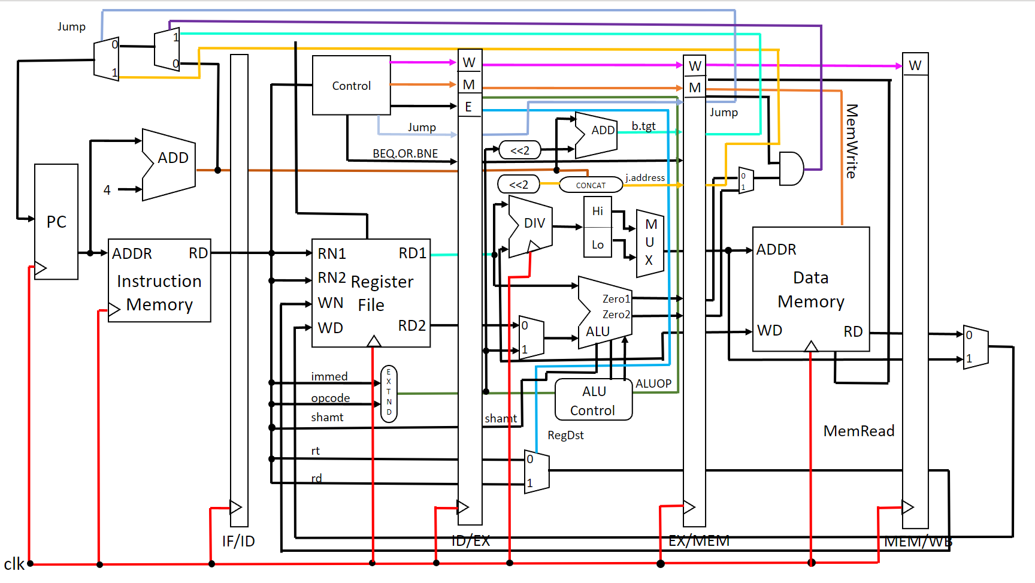
PcSrc
Regwrite
opcode
6
Branch
PcSrc
jumpoffset
Zero.out
Regwrite
DIVU
rs
MemtoReg
32
5
rt
5
ALUSrc
16
32
6
6
5
5
5
copyright@ 資訊二甲 第三組

